Slide 1
Mille Lacs Perch VPA

Slide 2
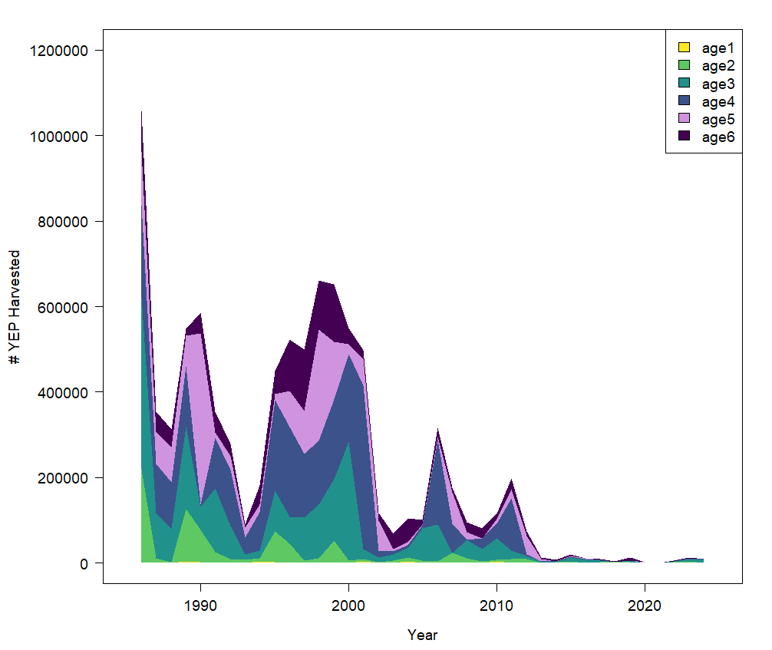
Data Sources
Recreational Fishery Catch data
Prior to 2000 all data age data was collected via scales.

Slide 3
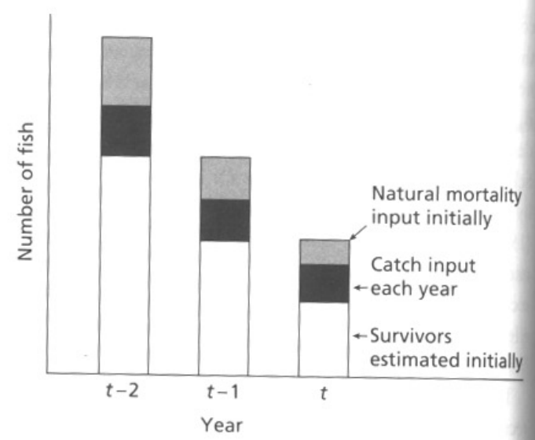
VPA
General Principle is to rebuild stock backwards through time using known harvest and natural mortality.
Jennings, Kaiser, and Reynolds 2001

Slide 4
VPA Assumptions
No observation error in harvest data
Natural mortality is known
Catch is assumed to occur instantly in middle of year (Pope’s approx.)
Terminal F (or exploitation rate) is known ahead of time
Value of F during last year of time series.

Slide 5
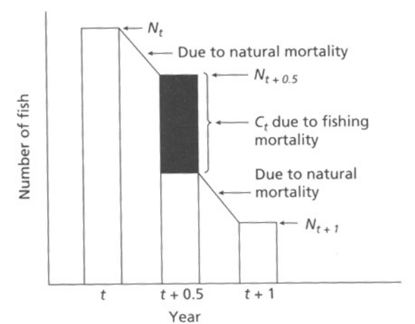
Pope’s Approximation
Jennings, Kaiser, and Reynolds 2001

Slide 6
VPA
I took two approaches to the VPA
“Simple model” – Uses all the same assumptions listed earlier
Gulland Approach
Assume F is constant for last two age groups (F_{t,5}=F_{t,6})
Assume F_{t=T}is the mean of the previous last three years
Assume C_{t=T,a}=N_{t=T,a}*(F_{t=T,a}/Z)*(1-S_{t=T,a})
We can then optimize the VPA process to find a solution for the Terminal F_{t=T,6}. This then provides us time and age estimates of F.
I liked this approach because having values of F would be useful down the road.
It also prevented us from having to apply a single exploitation rate or Terminal F

Slide 7
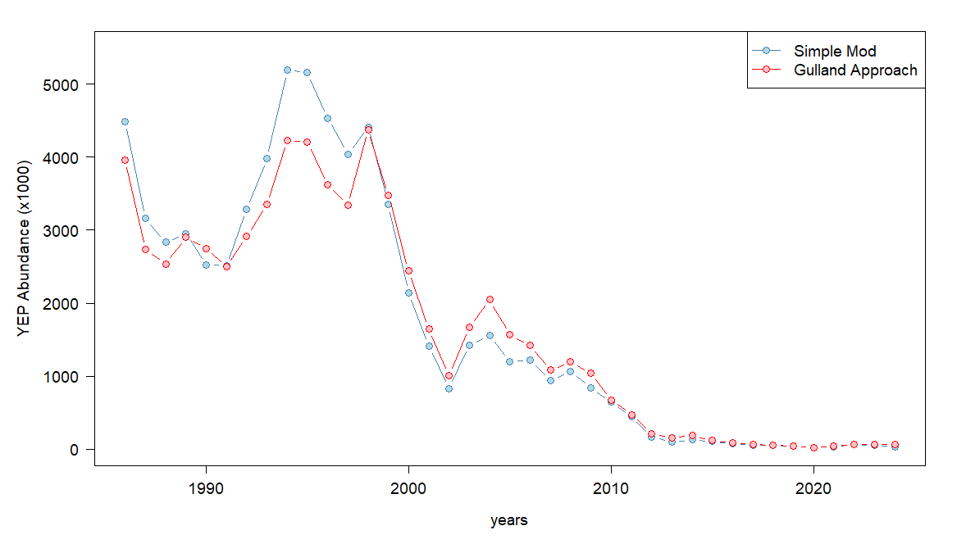
Results – Total Abundance

Slide 8
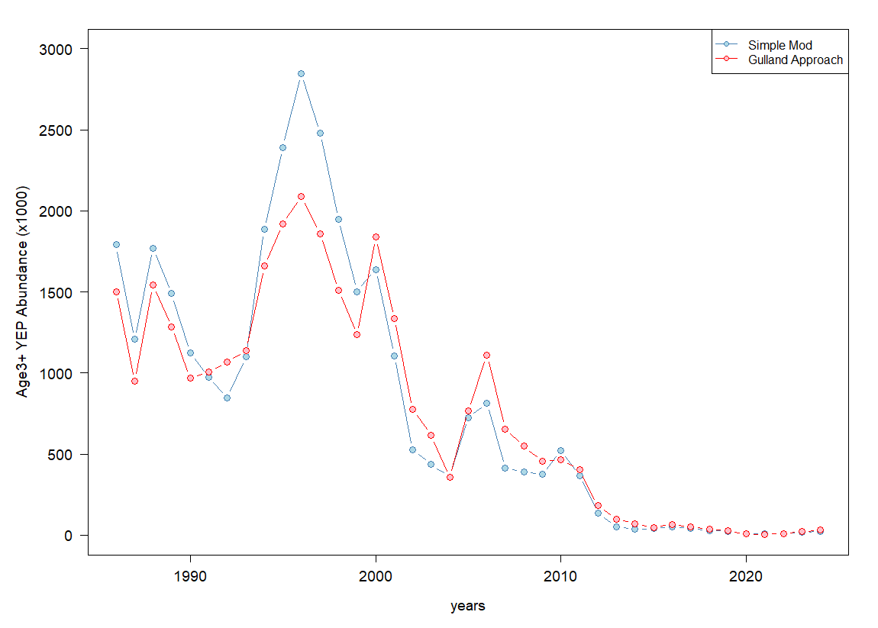
Results Age 3+

Slide 9
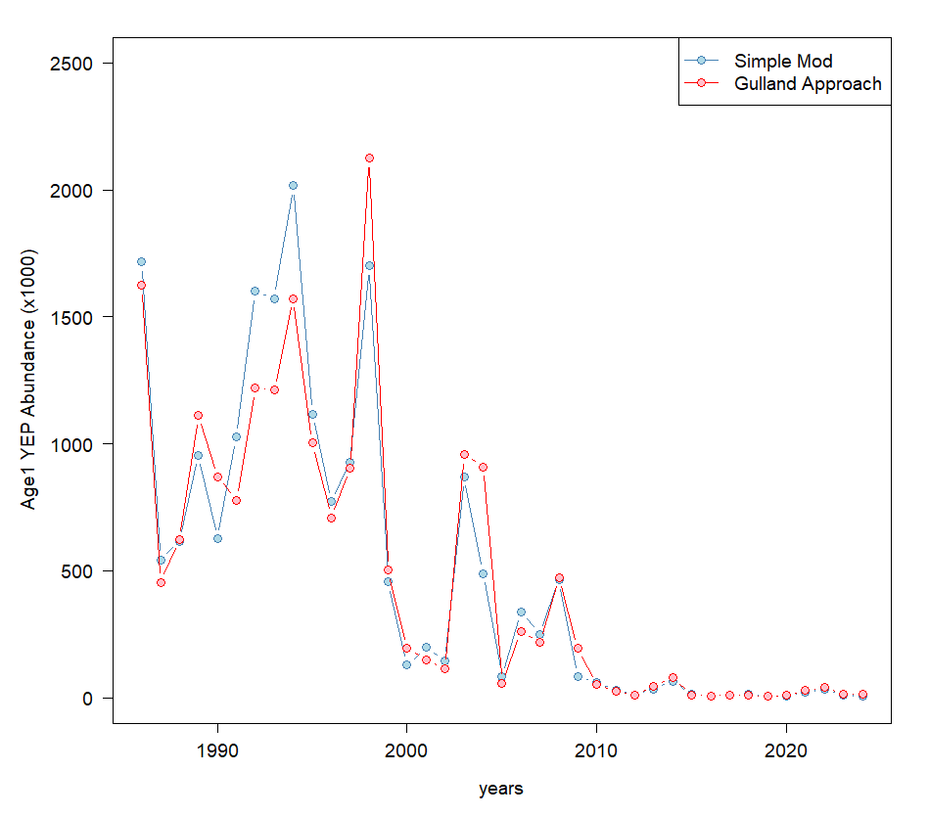
Results Age-1 Abundance

Slide 10
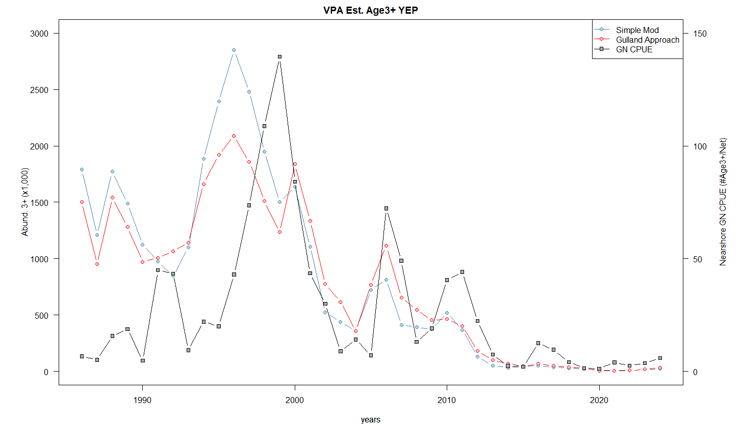
VPA Results vs Gillnet Survey
Weird time lag prior to 2000 – likely due to transition from scales to otoliths

Slide 11
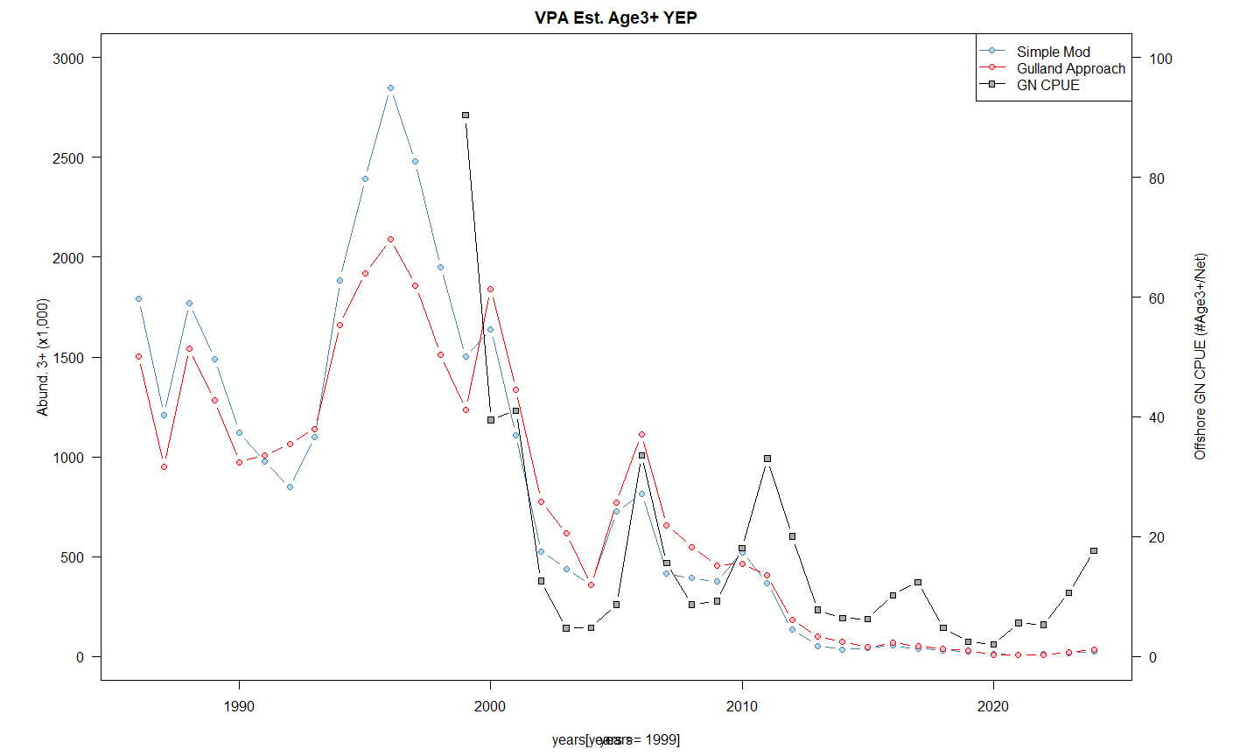
VPA Results vs offshore Gillnet Survey

Slide 12
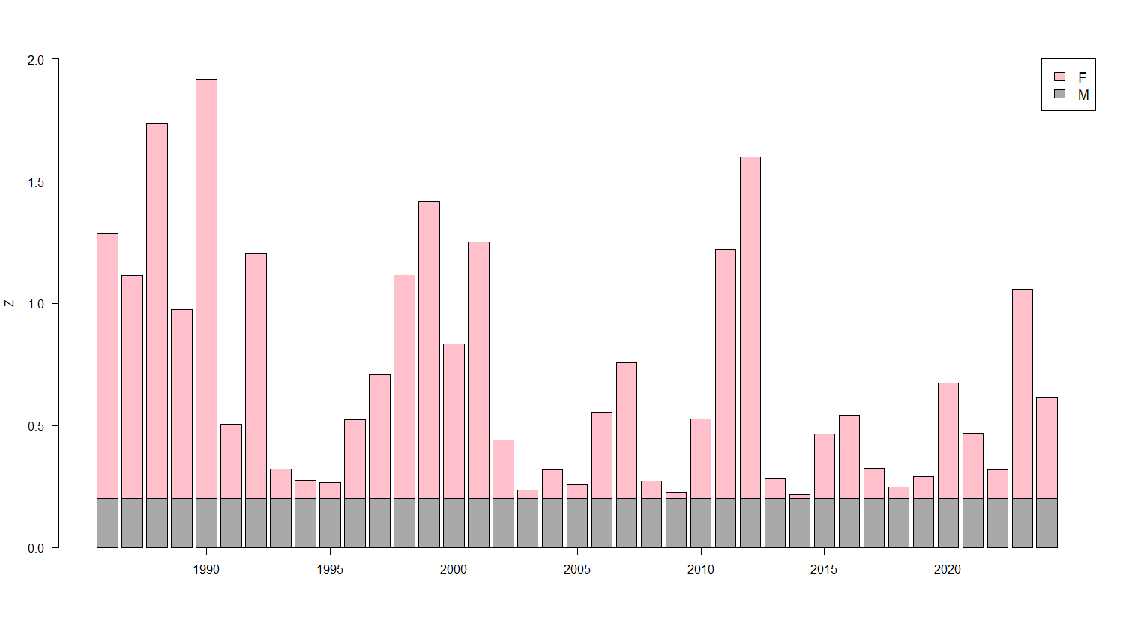
Mortality Estimates

Slide 13
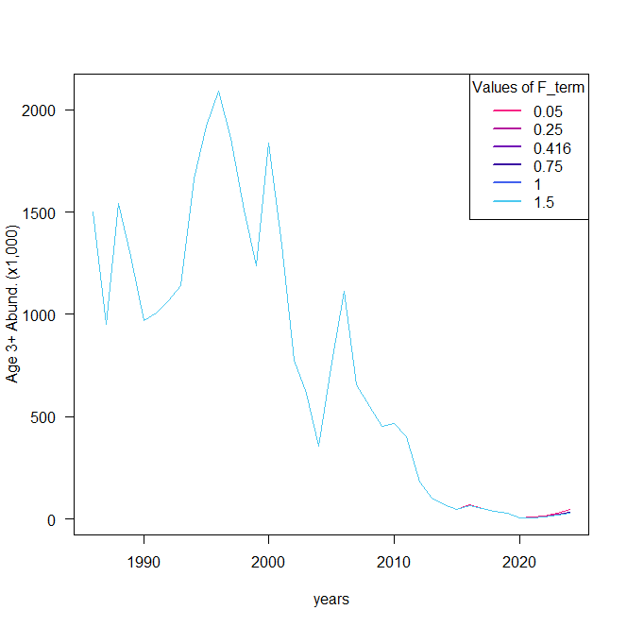
Sensitivity Analysis - Abundance
I reran the model with several different values of terminal F to see how big of an influence it makes in the Gulland model
The model appears to converge pretty quickly regardless of starting value.

Slide 14
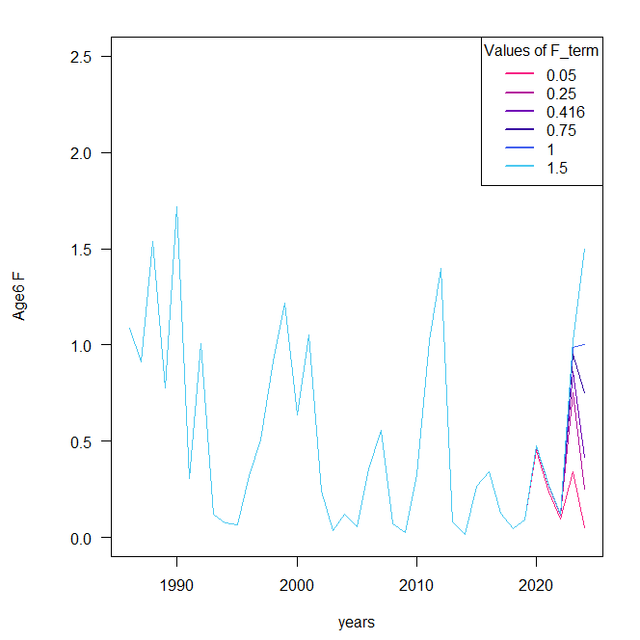
Sensitivity Analysis - F
Same thing for values of F.

Slide 15
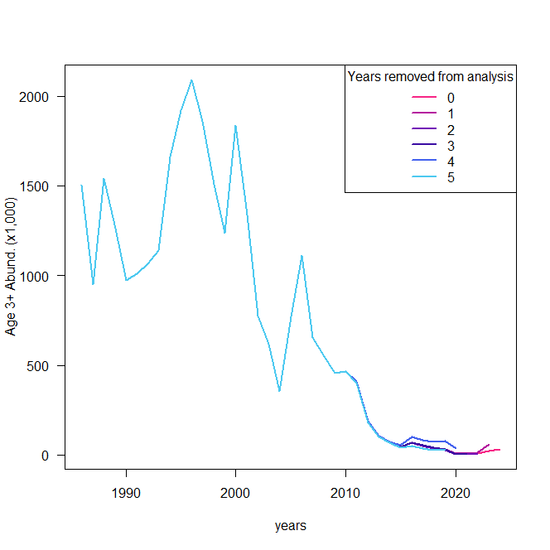
Retrospective Analysis
Again, the retrospective analysis appears to be pretty good as we’d expect.

Slide 16
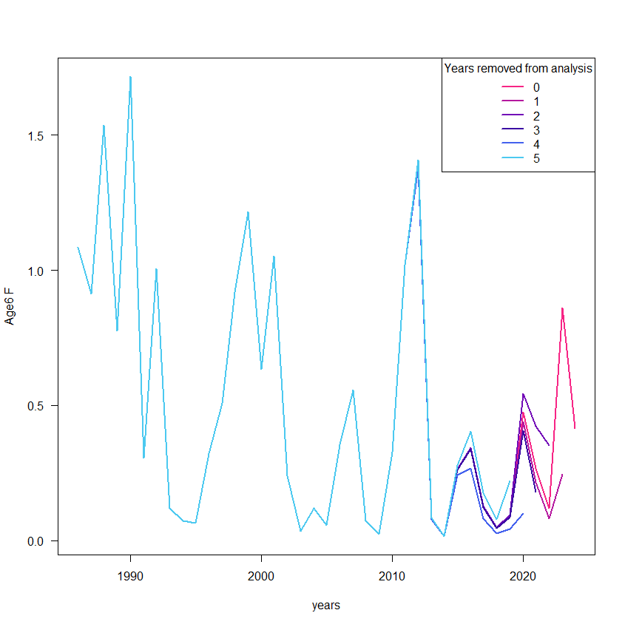
Retrospective Analysis
Same for values of F

Slide 17
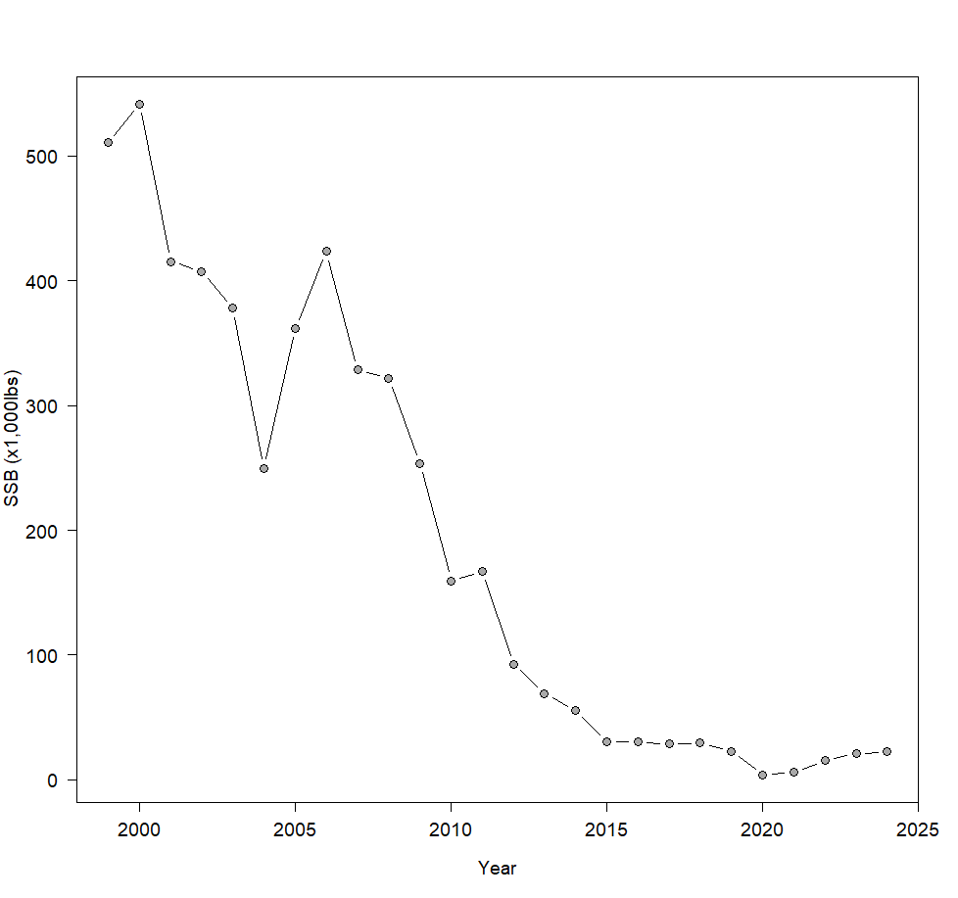
SSB
I was only able to calculate values of SSB going back to 1999. Bio data prior to the use of otoliths is not readily available and maybe not very trustworthy.

Slide 18
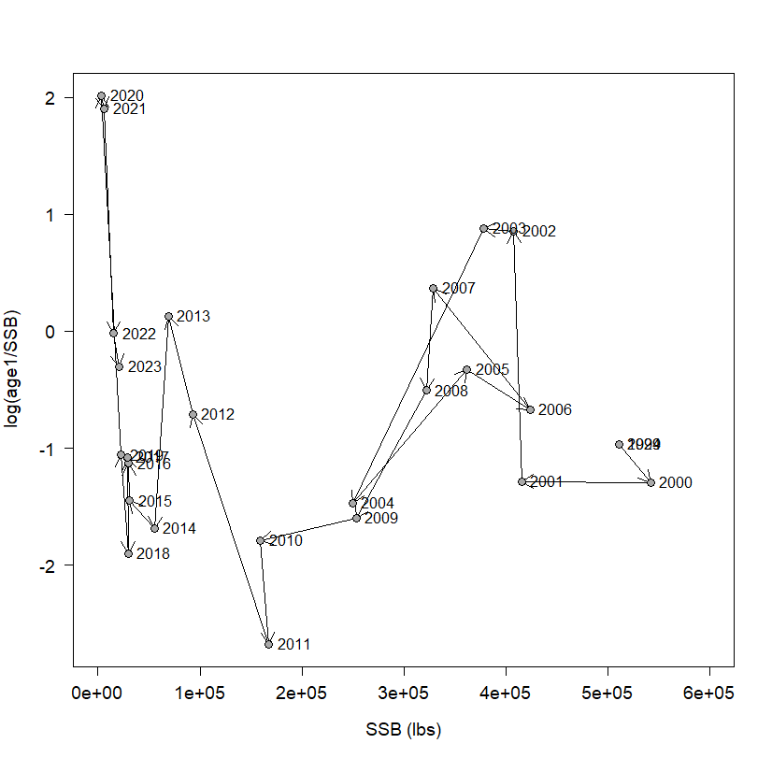
SSB-Recruit relationship
Post 2009
Pre 2009
The movement of the log(R/S) vs S plot suggestions a shifting baseline in the system.

Slide 19
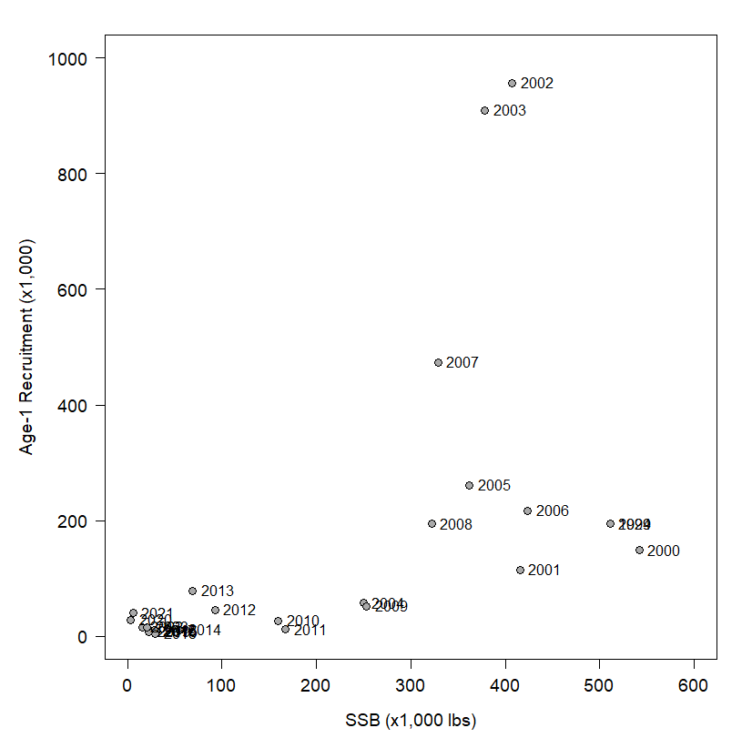
Stock/Recruit
What does this mean for the S/R relationship?
It’s messy…
If we didn’t know the years on this data we almost assume a depensatory recruitment pattern.
About the same pattern we saw in walleye
I could not get a standard S/R function to converge

Slide 20
S/R Modeling
Attempted models using all data
BH
Ricker
BH – with depen
Ricker – with depen
Ricker with temporal AR(1) on productivity parameter
Ricker with temporal Random walk on productivity parameter
Sbr0, recK, R0 parameterization
I have not spilt the data yet, trying to save that as a last option.

Slide 21
Next steps
Finalize S/R relationship modeling
Solicit ideas from this group.
Identify Fmax and Bmsy
Might have to do this twice if we spilt the dataset.

Slide 22
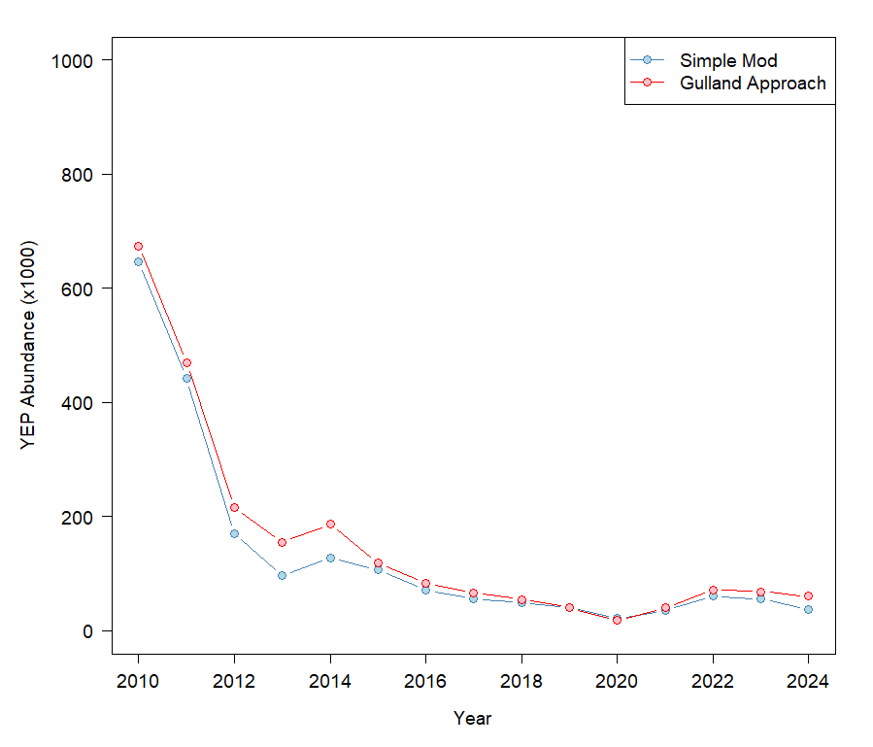

Slide 23
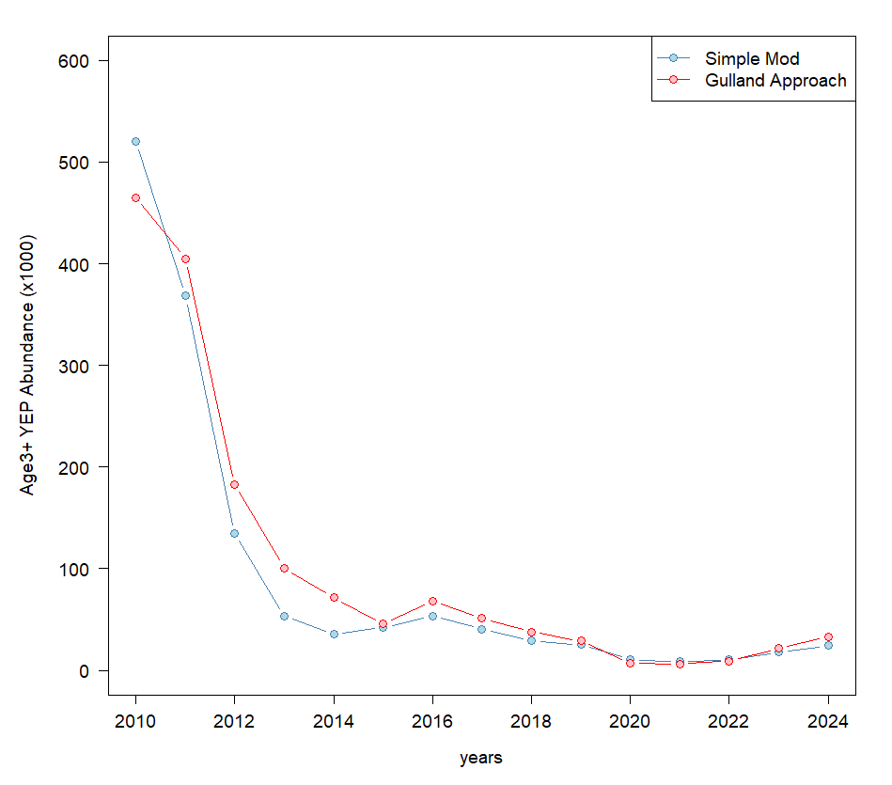

Slide 24
